Slide 1
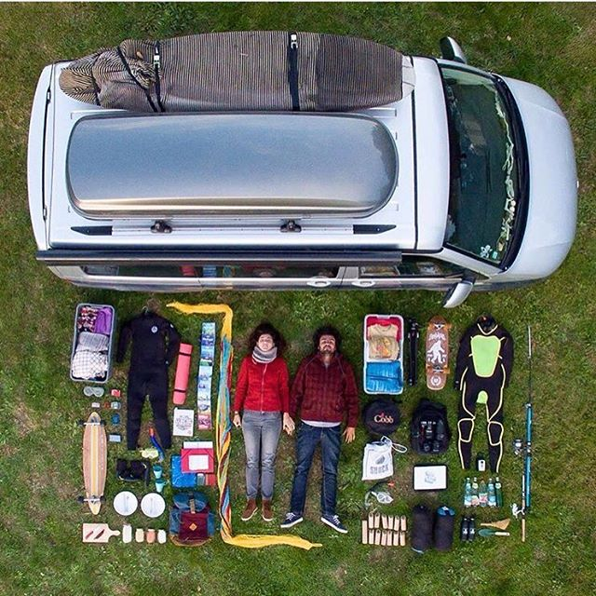
#roadtrip
#vanliving
#campervan
Notes:
Good tags

Slide 2
#goals
#instanature
#yoga
Notes:
BAD tags

Slide 3
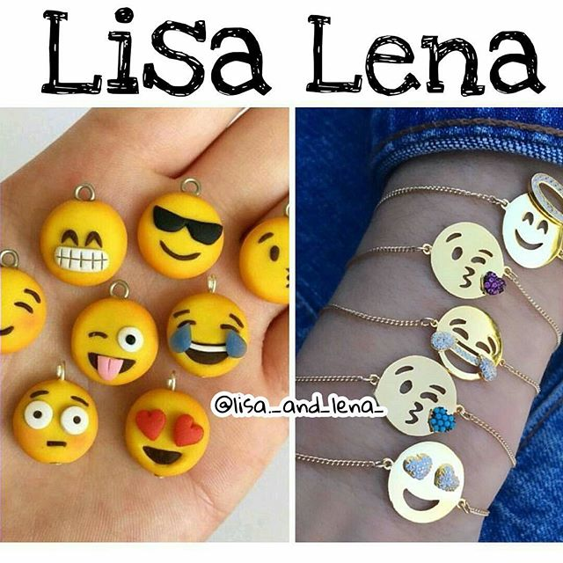
#dog
#hair
#beach

Slide 4
#Handmade
#bracelet
#emojis

Slide 5
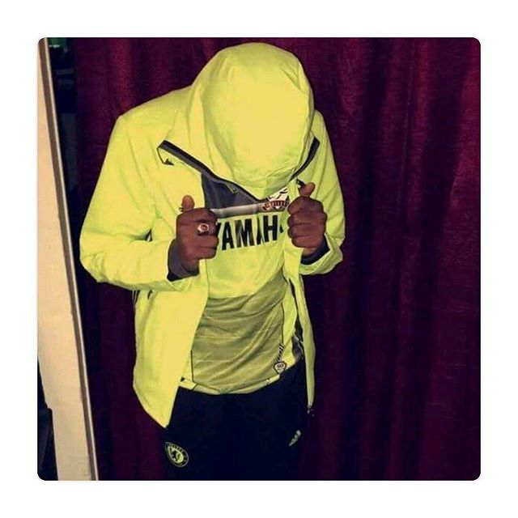
#french
#wanderlust
#zen

Slide 6
#hoodie
#yamaha
#whatiwore

Slide 7
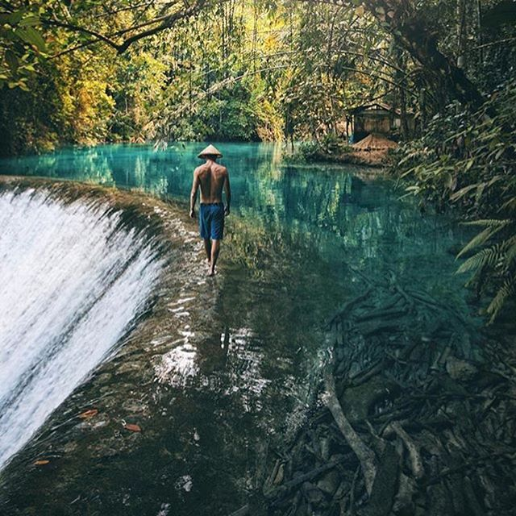
#wildernessculture
#lake
#beautifuldestination
Notes:
Good tags

Slide 8
#traveleurope
#sunset
#sunrise
Notes:
Bad tags

Slide 9
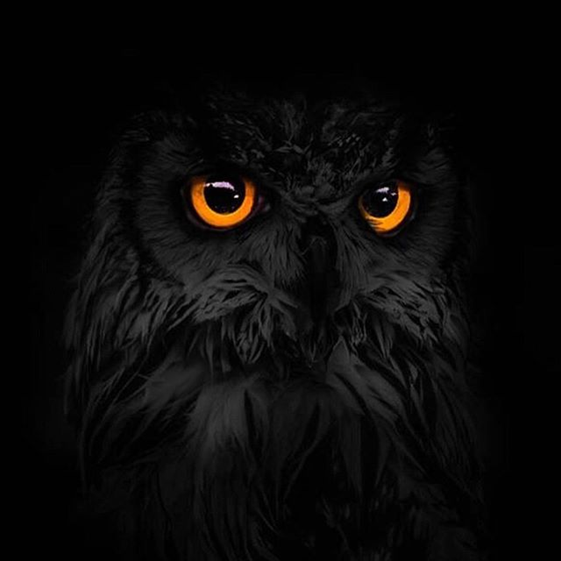
#dog
#cat
#petsagram

Slide 10
#animals
#nature
#blackowl

Slide 11
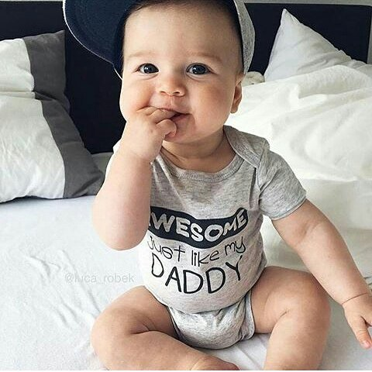
#follow4follow
#hair
#food
#cat

Slide 12
#dadlife
#babybrother
#babystyle

Slide 13
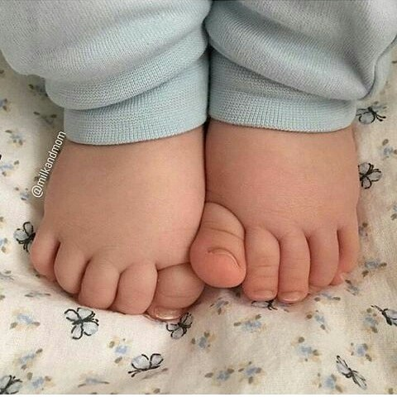
#follow4follow
#hair
#food
#cat

Slide 14
#babytoes
#tinytoes
#snugglebug

Slide 15
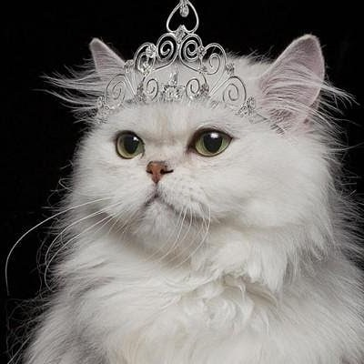
#queen
#king
#white

Slide 16
#persiancats
#whitecat
#chinchillacat

Slide 17
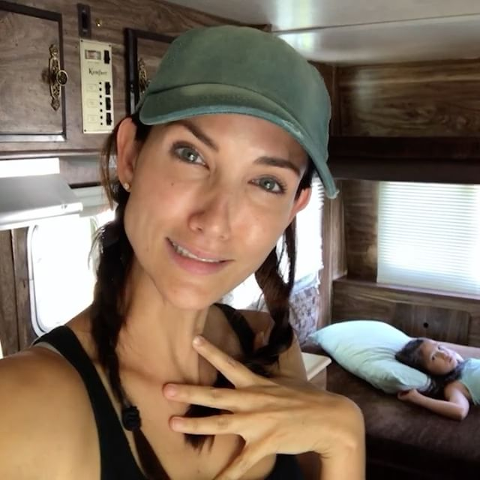
#aintnoRitz
#goodtimes
#howdidyouwipeyourbutt

Slide 18
#rvcamping
#familytravel
#travelvlog

Slide 19
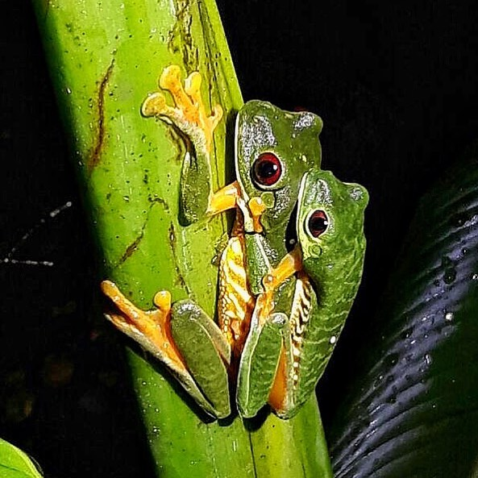
#costaricaluxury
#luxurytravel
#familytravel

Slide 20
#amplexus
#visitcostarica
#treefrog

Slide 21
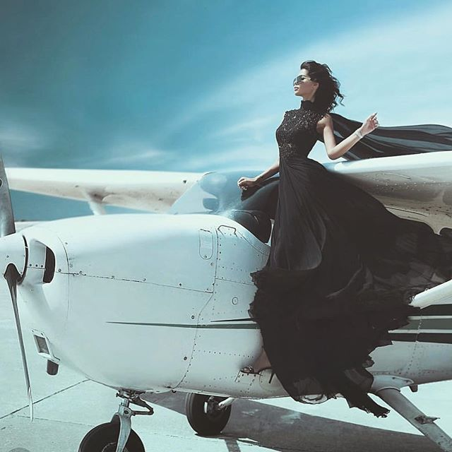
#darlingweekend #makeupjunkie
#jewelryaddict

Slide 22
#luxurytravel #privateplane
#fashionphotography

Slide 23
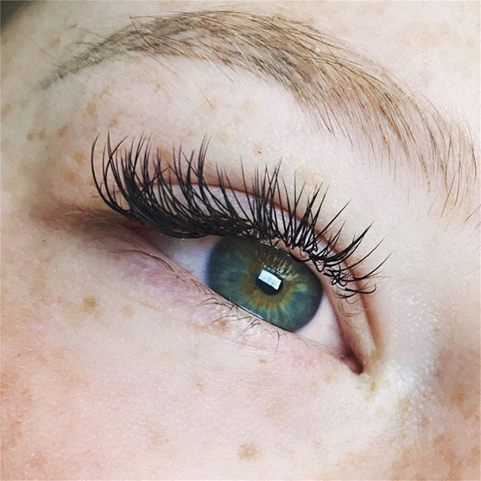
#ventura
#lookamillion
#lipsense

Slide 24
#lashartist
#lashextensions
#lashlove

Slide 25
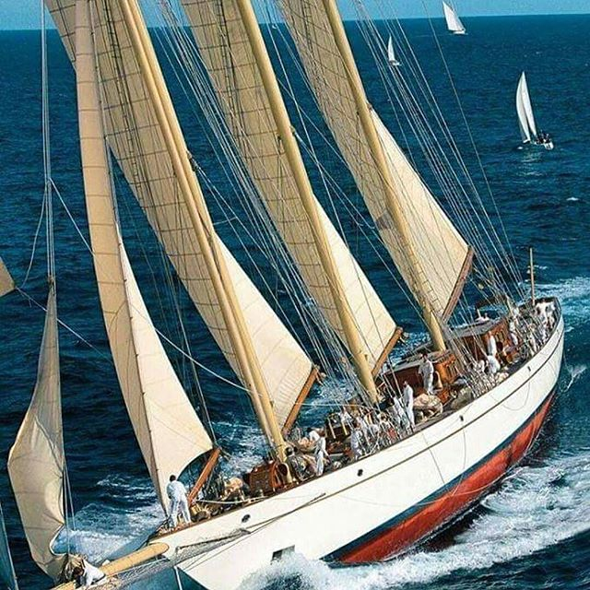
#beautyguru
#BeautySalon
#katvondbeauty

Slide 26
#Tallships
#Tallshipsrace
#Tallshipsfestival

Slide 27
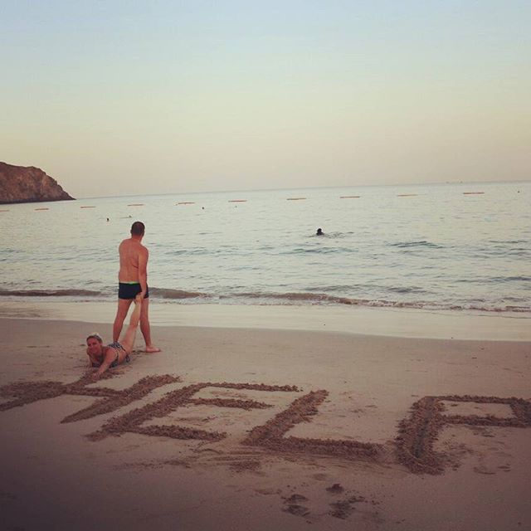
#ocean
#beach
#help

Slide 28
#hotel
#swimingpool
#photo

Slide 29
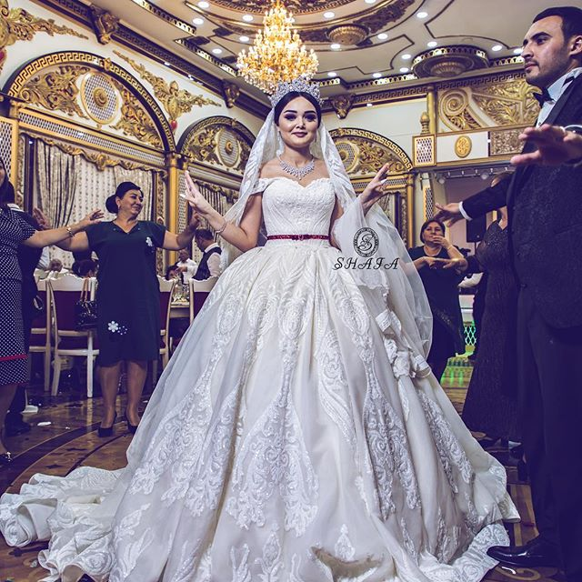
#instalike
#instagood
#instadaily

Slide 30
#weddingday
#weddingdress
#weddingbaku

Slide 31
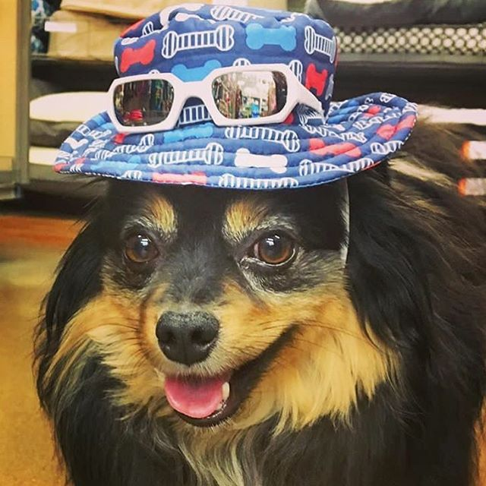
#dogsofinstagram
#dogfashion
#dogmom

Slide 32
#travel
#vacay
#cute

Slide 33
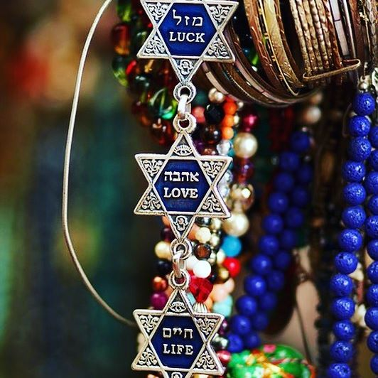
#sightseeing
#summer
#beautifuldestinations

Slide 34
#JewishGifts
#JewishJewelry
#StarofDavid

Slide 35
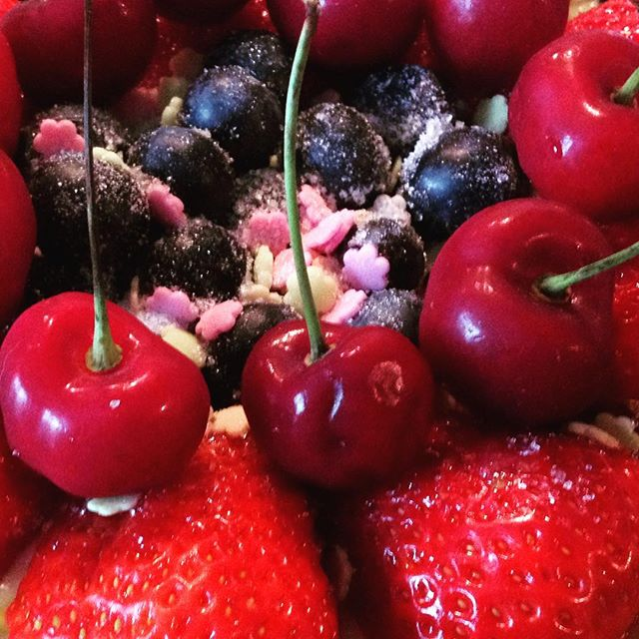
#color
#photo
#fashionblogger

Slide 36
#dessertporn
#fruitstagram
#freshfruits

Slide 37
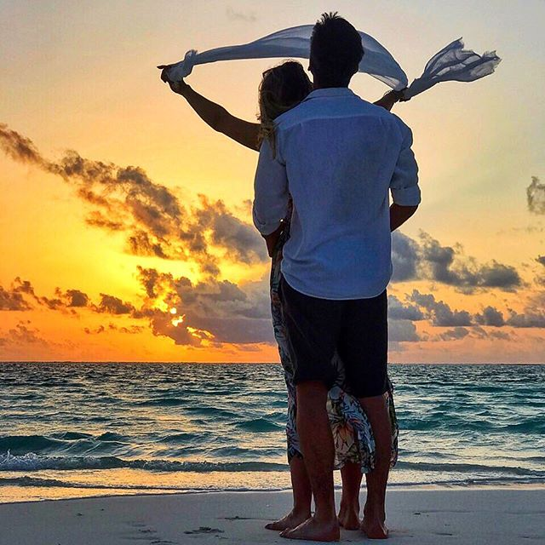
#sunset
#couplegoals
#beach

Slide 38
#instatravel
#instagood
#tripstagram

Slide 39
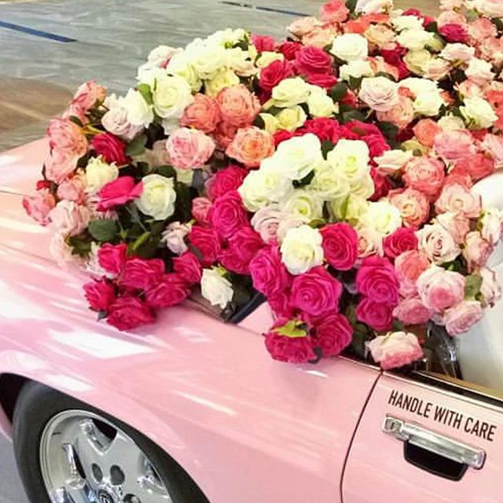
#passportready
#photooftheday
#journey

Slide 40
#pinkroses
#flowerdesign
#flowershop

Slide 41
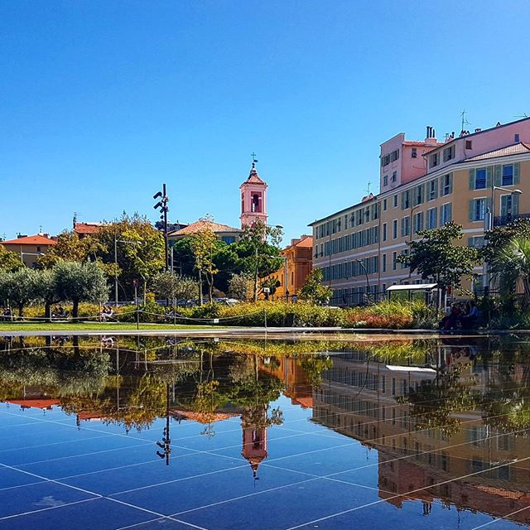
#Reflectionpic
#BlueSkyDay
#Reflectiongram

Slide 42
#instago
#igers
#sunrise_and_sunsets

Slide 43
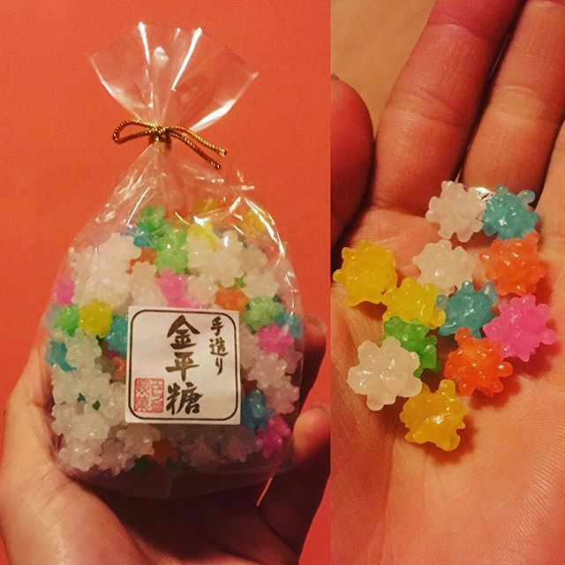
#japanesesweets
#japanesecandy
#konpeito

Slide 44
#sogood
#itssocute
#travel

Slide 45
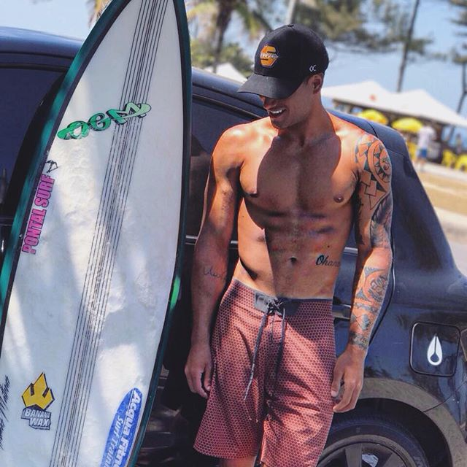
#surflife
#beachday
#hotguyswithtattoos

Slide 46
#follow
#likeforlike
#f4f

Slide 47
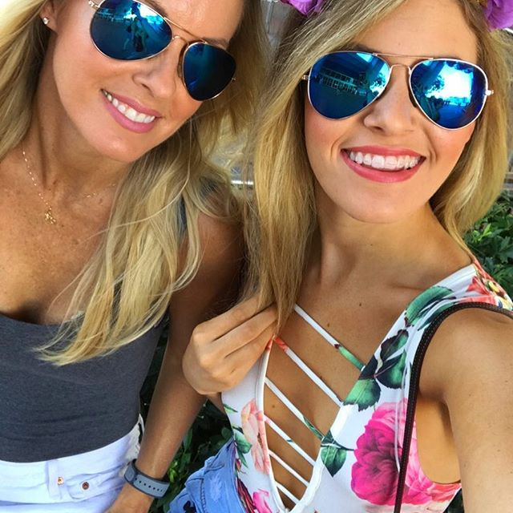
#fishing
#mexico
#sharks
Notes:
Celeb with irrelevant hashtags – which were then copied by his followers tag for tag https://www.instagram.com/p/BZUE4x-HpPP/?hl=en&tagged=fishing

Slide 48
#selfiegram
#sunglasses
#vacationmode
Notes:
Celeb with irrelevant hashtags – which were then copied by his followers tag for tag https://www.instagram.com/p/BZUE4x-HpPP/?hl=en&tagged=fishing

Slide 49
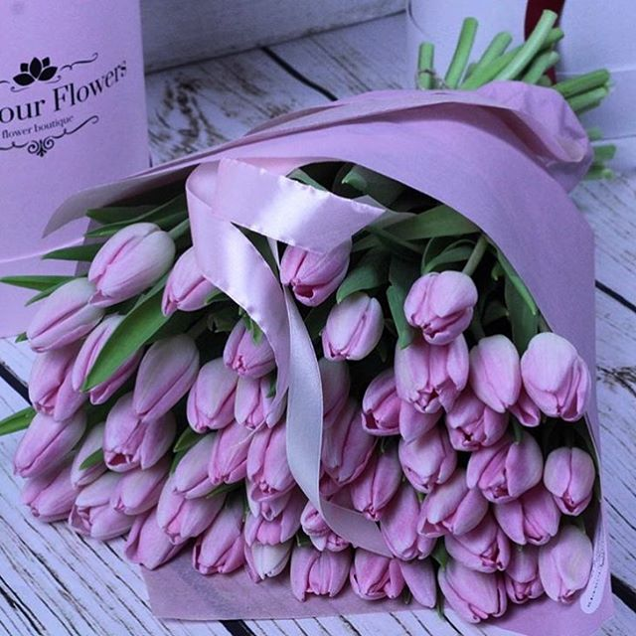
#picoftheday
#positivethoughts
#instagood
Notes:
https://www.instagram.com/p/BZUOAAkj-J6/?hl=en&tagged=fishing don’t copy hashtags

Slide 50
#pinktulips
#bloomandgrow
#bouquetoftheday
Notes:
https://www.instagram.com/p/BZUOAAkj-J6/?hl=en&tagged=fishing don’t copy hashtags

Slide 51
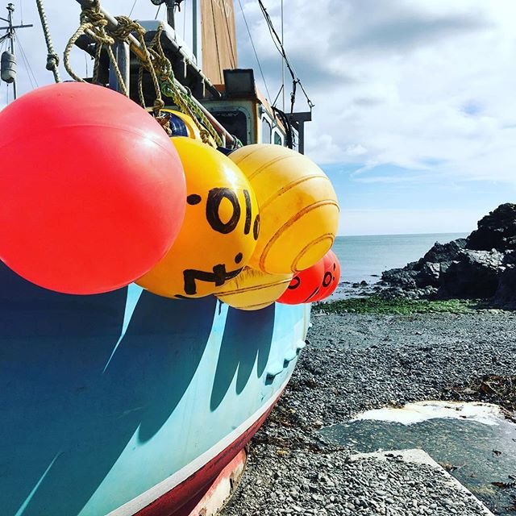
#fishingboat
#buoy
#cornishcoast

Slide 52
#blue
#autumn
#sunshine

Slide 53
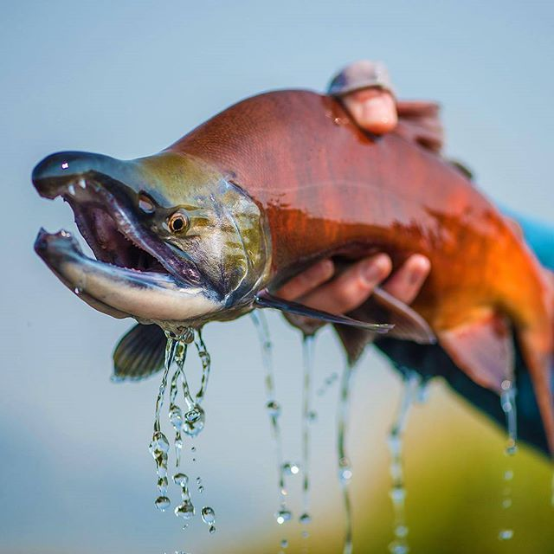
#photographysouls
#fire
#VSCOCam

Slide 54
#flyfishingphotography
#troutfishing
#catchandrelease

Slide 55
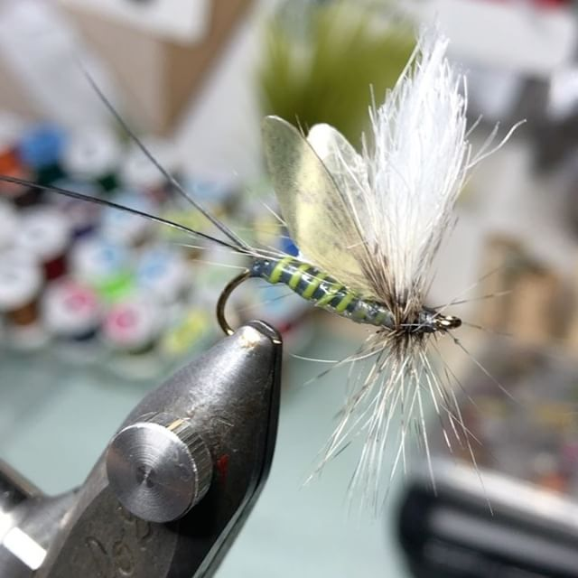
#flyfishing
#flytying
#flytyingaddict

Slide 56
#rainbowtrout
#soca
#adventure

Slide 57

#wanderlust
#beautifuldestinations
#naturelovers

Slide 58
#droneoftheday
#urbanlandscape
#asphaltjungle

Slide 59
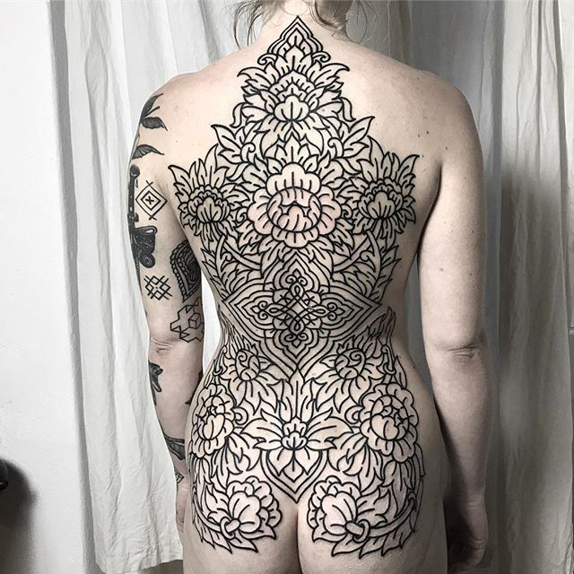
#blackworktattoo
#mehinditattoo
#hennatattoo

Slide 60
#berlin
#paisleytattoo
#tattoosleeve

Slide 61
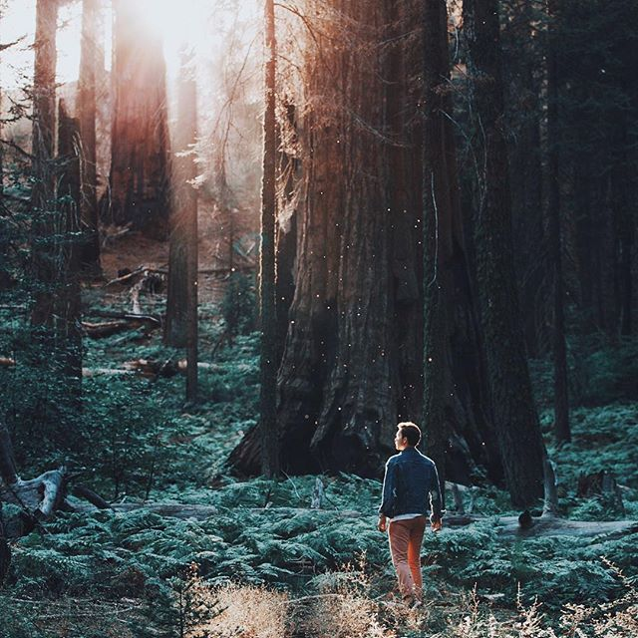
#wonderful_places
#bestvacations
#passionpassport

Slide 62
#redwoodforest
#outdoors
#gocamping

Slide 63
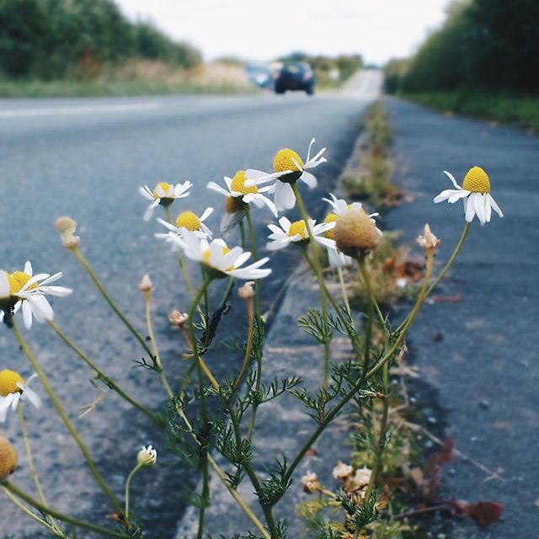
#gothictonic #heitermoments #amomentofwonder

Slide 64
#daisies
#flowermagic
#bloomandgrow

Slide 65
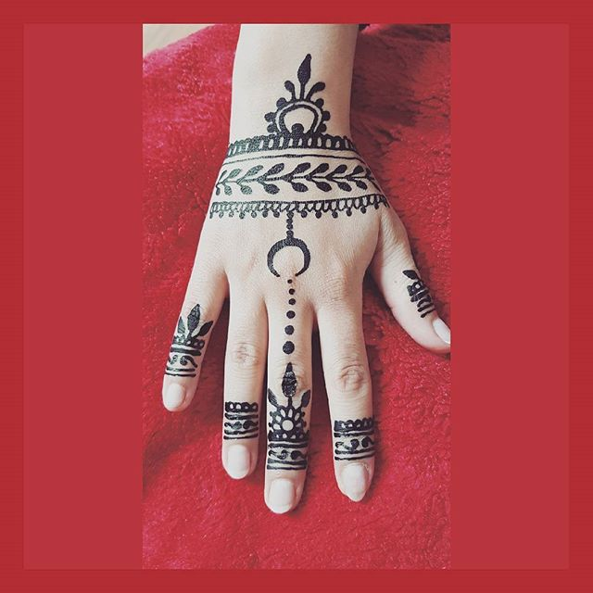
#artsy
#me
#love

Slide 66
#hennatattoo
#hennaartist
#hennalove

Slide 67
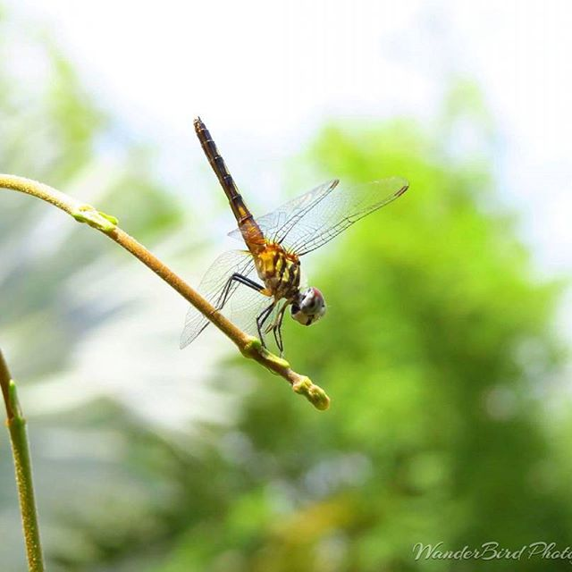
#explore
#Florida
#spacecoast

Slide 68
#naturelovers
#insectlicious
#dragonfly

Slide 69
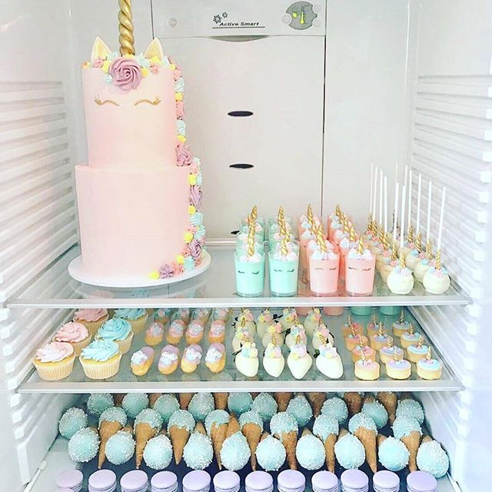
#fridgesituation
#fridgegoals
#unicorncake

Slide 70
#foodie
#pretty
#christening

Slide 71
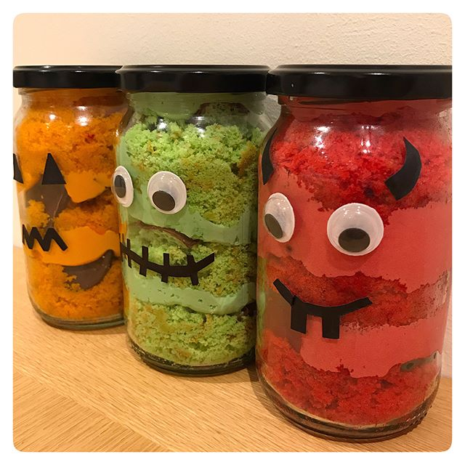
#bakersofig
#cupcakes
#buckshawvillage

Slide 72
#halloweencake
#cakeinajar
#halloweeninspo

Slide 73
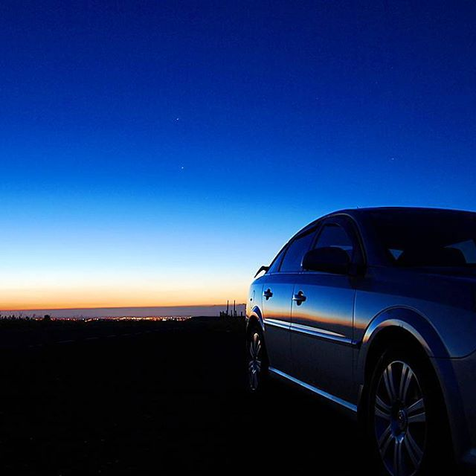
#wow
#nikon
#samsung

Slide 74
#sunset
#opel
#blackcar

Slide 75
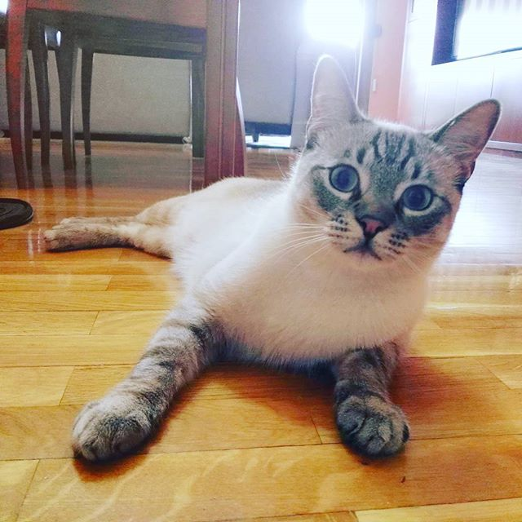
#catsonly
#gatos
#caturday

Slide 76
#goodmorning
#nude
#barcelona

Slide 77
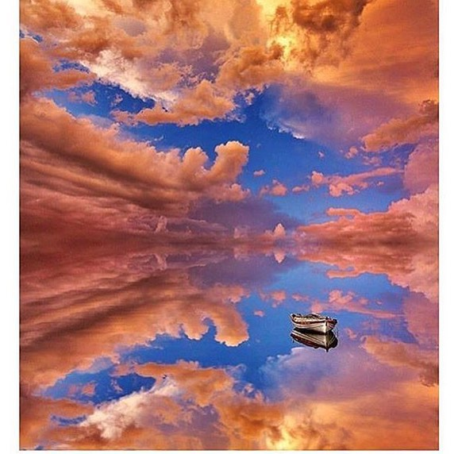
#Jesuslovesyou
#emmys
#followback

Slide 78
#reflectiongram
#pinkclouds
#reflectioninwater

Slide 79
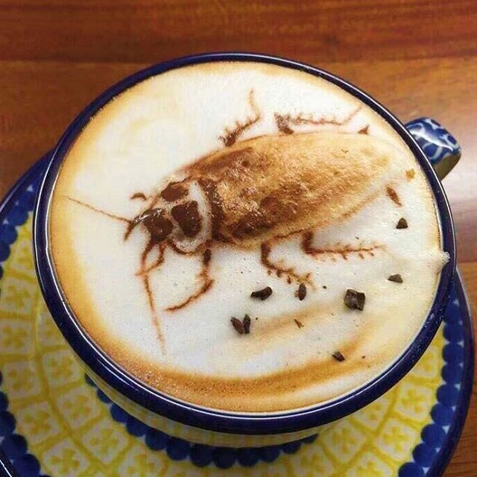
#latteart
#lattegram
#latteartfail

Slide 80
#cockroach
#infestation
#goodmorning

Slide 81
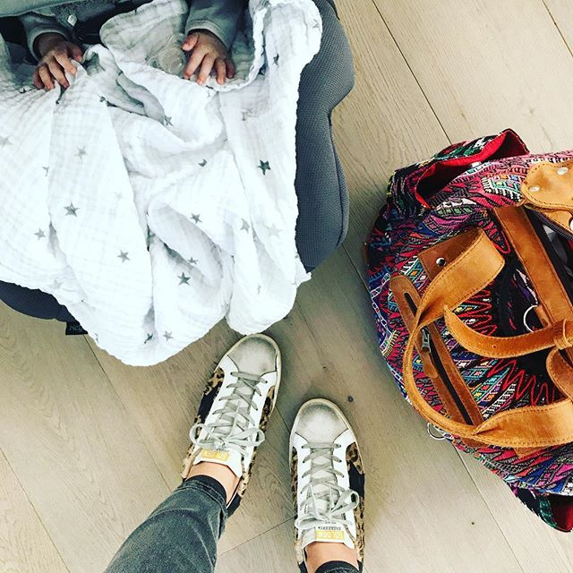
#momlife
#fromwhereistand
#diaperbag

Slide 82
#babygirl
#morninghustle
#positivevibes

Slide 83
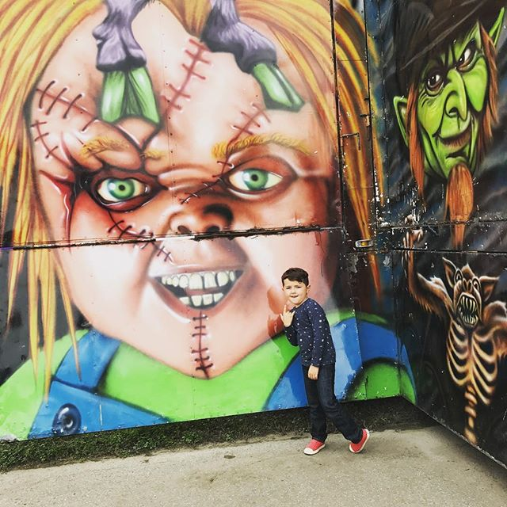
#momlife
#scaryart
#halloweendecor

Slide 84
#mykiddo
#funny
#shopping

Slide 85
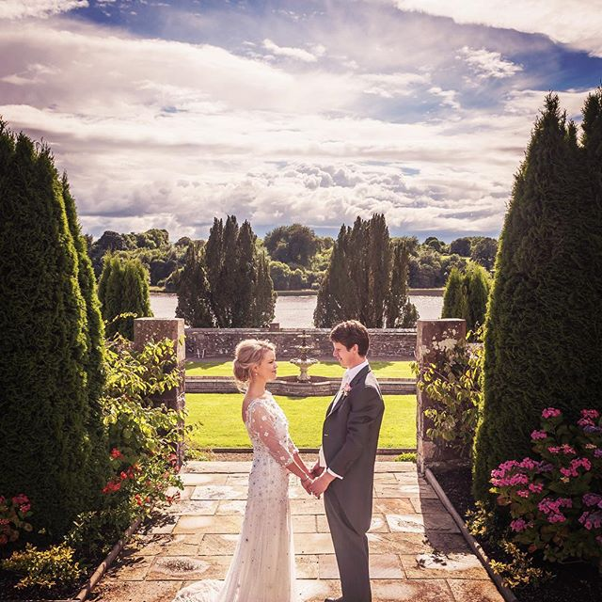
#wedding
#brideandgroom
#weddingday

Slide 86
#summer
#thehappynow
#theartofslowliving

Slide 87
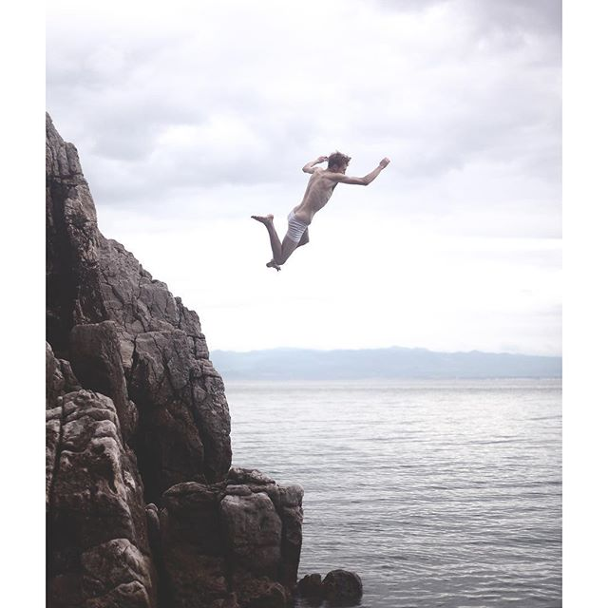
#streetstyle #whatiwore
#fashiondiaries

Slide 88
#cliffjumping
#jumpstagram
#taketheleap

Slide 89
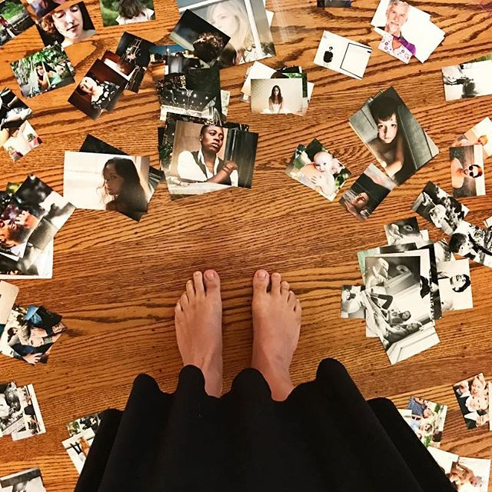
#FromWhereIStand
#PhotographerLife
#Photoprints

Slide 90
#LoveMyJob
#Hustle
#News

Slide 91
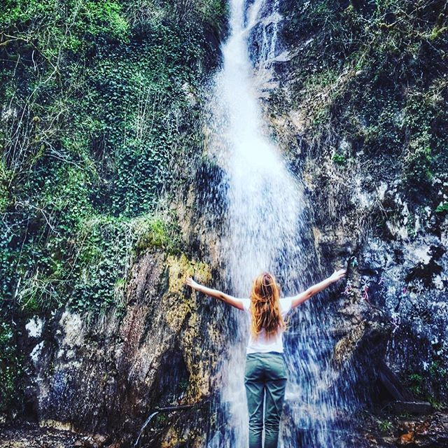
#waterfall
#chasingwaterfalls
#mountainside

Slide 92
#SoloBikeParking
#FriendsAndWalls #DoorsOfTheWorld

Slide 93
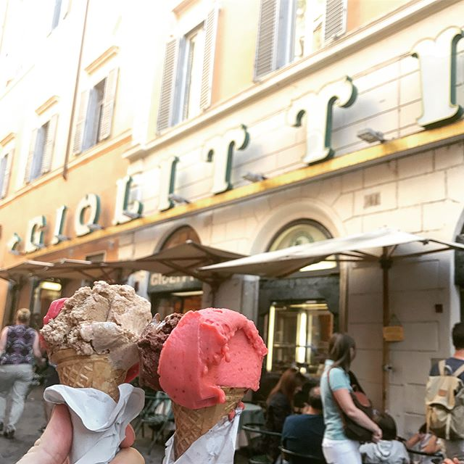
#rome
#vaticancity
#ihavethisthingwithfloors

Slide 94
#gelato
#wafflecone
#icecreamlovers

Slide 95
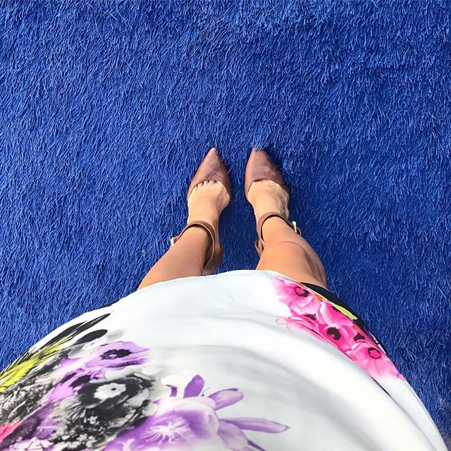
#fromwhereistand
#ihavethisthingwithcolor
#ootd

Slide 96
#oldmontreal
#griffintown
#livekindly

Slide 97
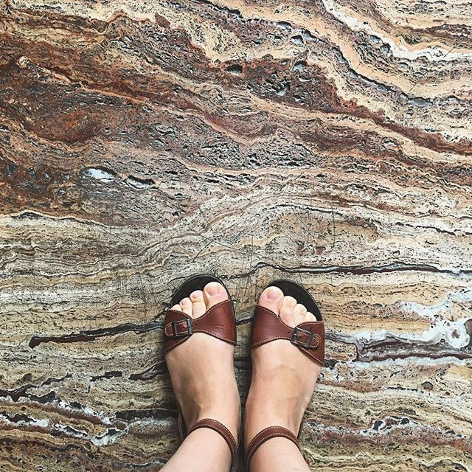
#ihavethisthingwithfloors
#marbletiles
#fromwhereistand

Slide 98
#browns
#chaostheory
#adventureawaits

Slide 99
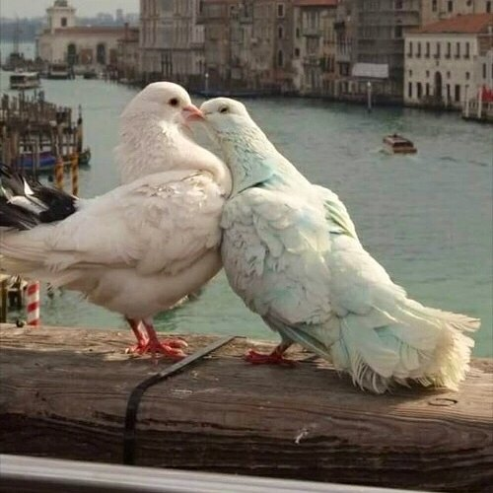
#tattoos
#bands
#tumblrgirl

Slide 100
#whitedoves
#birdstagram
#bridgepic

